Slide 1
Physical computing from Scratch using scratchClient – Beginners Control servos, LEDs and more from Scratch using RPi, Arduino, scratchClient
Hans de Jong & Gerhard Hepp
Pi And More 10
Trier – 24 June 2017

Slide 2
Part 1: Introduction

Slide 3
If the presentation is messed up …
You need the Calibri font on your Raspberry Pi (standard on Windows but not on Raspberry Pi).
Either obtain and install that font, or …
… look at the PDF version of the presentation
But in that version you cannot copy/paste.

Slide 4
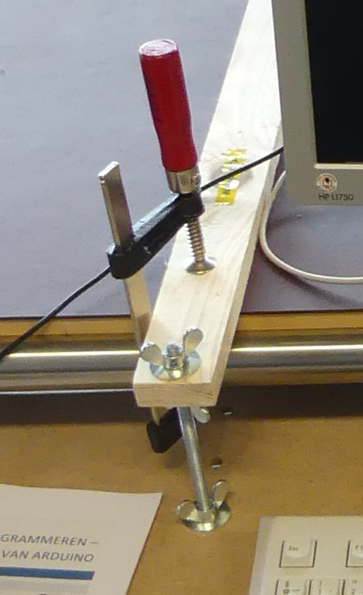
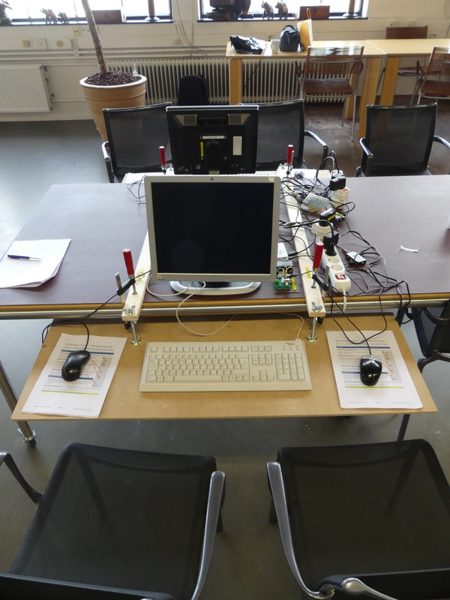
Ergonomics
At the Weekendschool we teach children 5 golden rules how to sit when using computers:
Rest your arms on the table in a natural fashion.
If you do not need the keyboard, move it up and give room to the mouse.
Have the monitor at arms length.
Change position (lean forward, backward etc.).
Frequently stop, walk around and exercise.
To change the height, use the two upper wingnuts.

Slide 5
Workshop organisation
Welcome and introduction presentation (10 min).
After that everyone will work at his or her own pace.
At times we will present for 5 minutes to explain a next concept.
Language: English, but help in German available.
At the end copy the material you created to your USB stick (if you want)
Cleanup.
The major steps:
Get a working hardware and scratchClient config using a Scratch test program.
Update scratchClient config (moving to other GPIO pins)
Write your own Scratch program to access the board.
Add more hardware (buzzer, tri-color LED, button, joy stick) and adapt scratchClient config and adapt the Scratch program.
If you want: have a look at the game used at the Weekendschool and program a bit yourself (but it is still in Dutch ☺ )
Start latest 30 minutes before the end of the workshop.

Slide 6
Objectives
At the end of today you should be able to:
Reproduce the setup at home (provided you have the hardware ☺ )
Understand
Digital output (e.g. lighting a LED)
Digital input (e.g. sensing a button)
Analog input (e.g. from a potentiometer)
Pulse Width Modulation (PWM)
For dimming LEDs
For controlling servos
For sounding a buzzer
Understand what all the resistors are for
Be able to configure and run scratchClient
Program Scratch to control the physical input and output
Monitoring the inputs and outputs
If time permits / as you desire: look at a game using servos, buttons, LEDs etc. as used on the Weekendschools in The Netherlands.
Have fun!

Slide 7
Non-objective
It is not an objective to create a complete useful game or other program.
You can do that with your own creativity at home now that you know how to control several pieces of hardware from Scratch using scratchClient.

Slide 8

Weekendschool
Generally parents tell their children: “Learn for later”. But what is later?
“I want to become an engineer. Do you maybe know an engineer? I would very much like to meet one”
Professionals teach children on Sundays about their job. Large variety of topics.
> 1000 students between 11 and 14 years from underprivileged areas.
Curriculum lasts for 2.5 to 3 years
3500+ volunteers.
Funded by 110+ sponsors (companies, individuals, foundations).
Started in 1998.
It works! Data shows: alumni have better professional prospects, are more self-aware, and feel more connected with society.
EINDHOVEN 58 students
IMC Weekendschool
Trudo Weekendschool

Slide 9
Lessons at the Weekendschool
I personally teach
Mathematics (since 2004)
Physics (since 2011)
Programming (started in 2016)
Electro (started in 2016)
Programming: 3 (2) lessons on 5 (3) Sundays with Scratch, Raspberry Pi and Arduino
Last lesson comprises 2 days but is optional and can be done in a later year.
Lesson 2: Physical computing: https://www.youtube.com/watch?v=Qo1gnXNzhqE

Slide 10
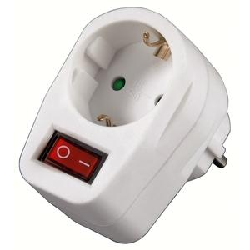
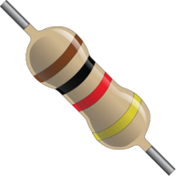
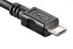


Only a few rules today
If Raspberry Pi needs to be rebooted, it needs a powercycle. Please do not pull plugs but use the switch in the outlet after you have done the shutdown.
Always put a resistor in series with the components when indicated.
If you think there is no need then please tell us and we will explain what the reason is (with one exception).
When changing the wiring
Stop scratchClient (just close the window)
Detach the USB cable from the Arduino Nano
Switch off the 9V power
Check, double check and check again whether the wiring is correct. You may blow up components when wiring wrongly!
Make sure that you both (4 eyes principle) are convinced the wiring is OK before turning on power again.
If something breaks down or gets damaged: we have some spare material
Do not put anything that is broken back into the box please.

Slide 11
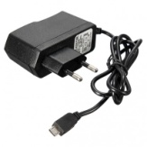
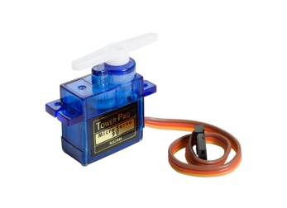
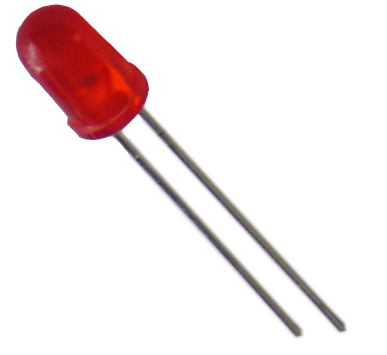
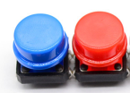


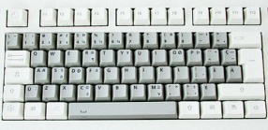
The setup
Raspberry Pi
2B or 3B
Powered USB hub
(Not used when programming the Arduino Nano)
(not strictly needed since Arduino is powered separately – used for protection of RPi)
Arduino Nano
Scratch 1.4 run time
scratchClient
scratchClient Sketch
Remote Sensor Protocol Over socket 42001
Global variables
Broadcasts
Program in Scratch
Predefined sprites (with some code, sounds and costumes)
scratchClient Config file
Defines function of the GPIO pins on the Arduino (and RPi) and gives them logical names.
Standard setup
Programmed by the students
Prepared by the teacher or expert

Slide 12
Where is the presentation?
You will find this presentation = the instruction at your desktop in the folder PiAndMore.
If you already know the stuff in the presentation and get bored then feel free to work on your own
Silently please … ☺

Slide 13
Part 2: Getting to know the components

Slide 14
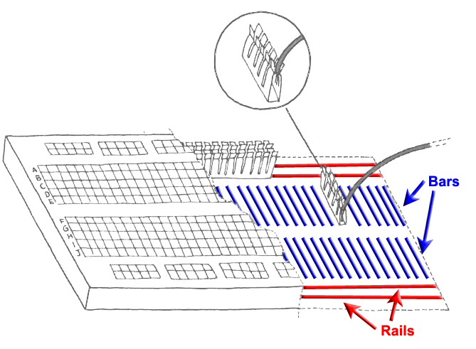
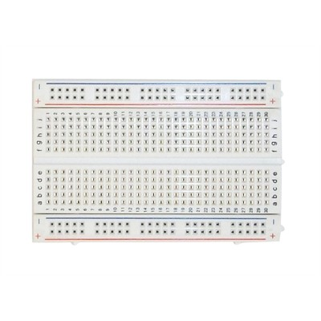
Breadboard
Used to quickly build electronic circuits
Note the 2 rails for + (VCC) and – (GND)
Note the 2 bars with 5 interconnected holes each.

Slide 15
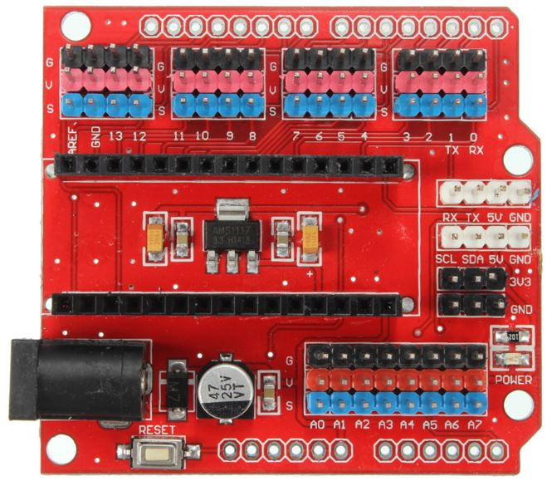
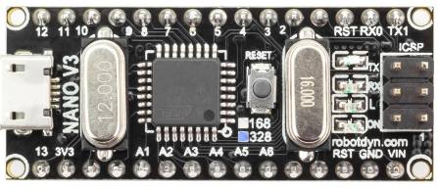
Looking at the Arduino Nano extension board
Analog ports (most can be used as digital ports as well)
Reset button
Per GPIO signal 3 headers:
S (blue = signal)
V (red = VCC = +)
G (black = GND = -)
(very handy to e.g.
connect servos)
9V power socket
Arduino Nano with 328P processor
Micro USB port
Reset button
Digital ports

Slide 16
What the final board looks like at the end of the beginners workshop …

Slide 17
… and after the advanced workshop

Slide 18
Part 3: Loading the sketch in the Arduino

Slide 19
Preparing for programming the Arduino Nano
Connect the Arduino Nano
Make sure to connect directly
not via the USB hub
for strange reasons it will not work via a (this) USB hub, although it used to in previous releases of Raspian (and still should).

Slide 20
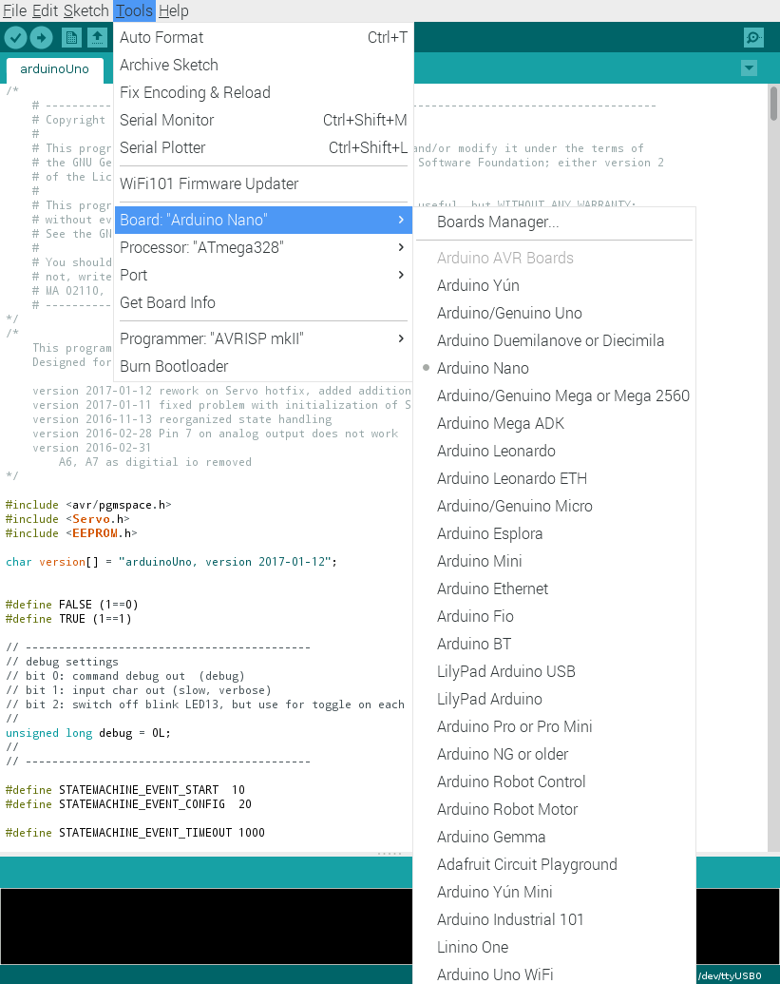
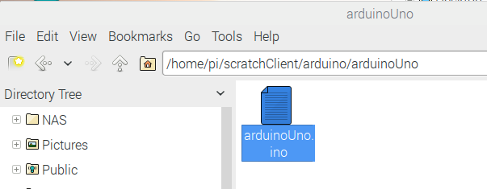
Uploading scratchClient to the Arduino
Make sure that the Arduino is directly connected to the Raspberry Pi (not via the USB hub)
Open the scratchClient sketch for Arduino Uno in /home/pi/scratchClient/arduino/arduinoUno
Double click to open the Arduino IDE
Click Tools and make sure that these are set:
Board: Aruino Nano
Processor Atmega328
Port: the port where the Arduino Nano is connected (normally /dev/ttyUSB0)
Click on the Upload button.
Wait till the completion of the Upload is reported.

Slide 21
Part 4: Defining the configuration
Give names to pins and define the purpose of the pin

Slide 22
Starting the config tool
This creates config files to map between Arduino pins and logical names.
Navigate to /home/pi/scratchClient/tools
Doubleclick scratchClientConfig.sh and chose Execute.
If the file opens rather than presenting the choice, then you must set execute permissions first.
To set permissions: right click on the icon, choose properties, then permissions and set execute rights to at least owner.

Slide 23
Define the first config file
Double click a cell to get a drop down menu
First for direction then for function.
Make sure to give all pins a name if you choose something else than void
So make sure not to save if you still have red borders around cells. scratchClient will fail to start with such a config file.
The tool checks wrong configurations. Examples:
Pins 0, 1 and 13 cannot be used at all
Analog in only available on A0 to A7
Pins A6 and A7 can only be used for analog in
Pins 9 and 10 cannot be used for PWM if any pin is configured for servo (see later)

Slide 24
Save the config file
Save the file in the folder PiAndMore on the desktop
Call it PiAndMore.xml
Leave the tool open for the next exercises.

Slide 25
Part 5: Wiring the board and run the first setup

Slide 26
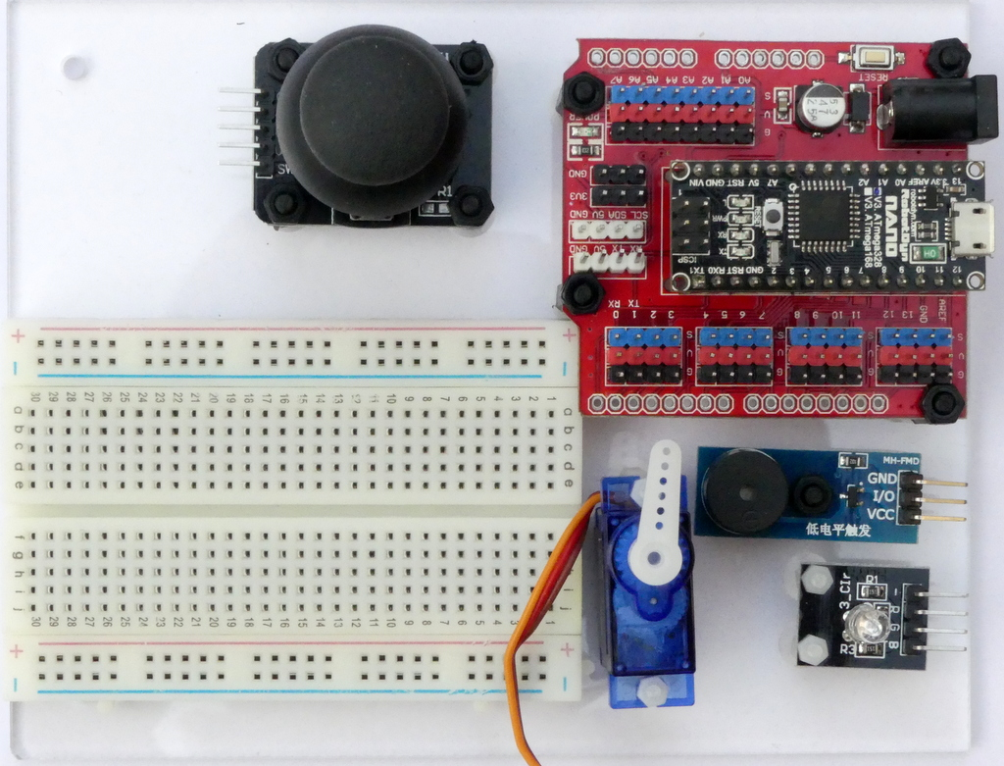
Put the board in front of you in this way

Slide 27
Use short wires and se the indicated holes
There are some short wires (10 cm) and some longer (15 cm)
Use the shortest that you can
Get a less messy setup
You may run out of long wires
You can in principle build up at different places on the breadboard
However, please use the indicated columns to avoid running out of space on the breadboard in the later part of the exercise.

Slide 28
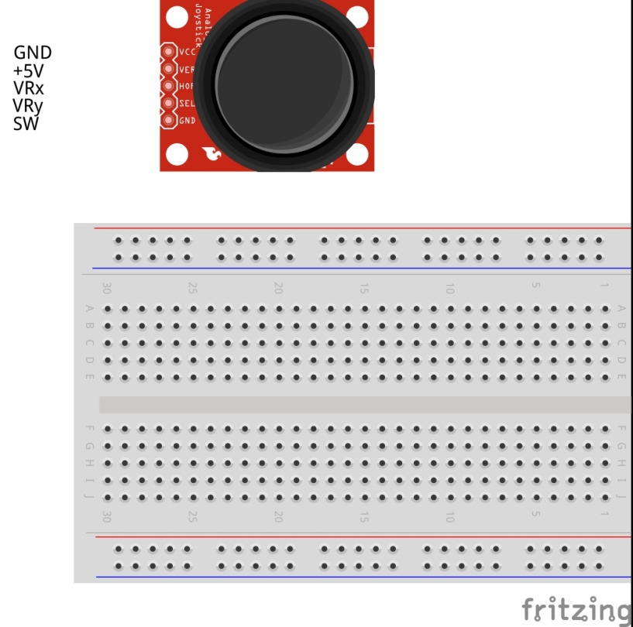
Connect the power wires

Slide 29
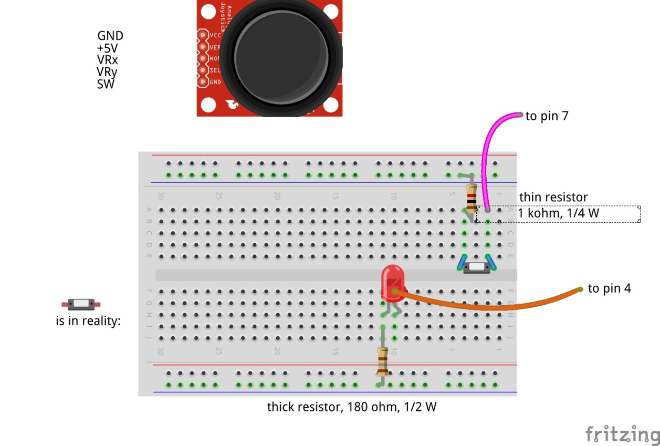

Insert the red LED and button

Slide 30
Why are these resistors needed?
In series with a LED: to limit the current through the LED
You may blow up the LED and/or the Arduino otherwise.
In series with buttons, potentiometers etc: to avoid blowing up the Arduino in case of config errors
+5 Volt
Consider what would happen if the 1 kOhm resistor were not there and the port would be used as output and the button closed.
Then the Arduino would output 5 Volt, and the switch is directly leading it to the 0 Volt line → short circuit!
Arduino
This is a pull-up resistor that sits in the chip on the Arduino Nano
Digital input
30 kOhm
1 kOhm
0 Volt

Slide 31
Check / double check
Please now check both of you that the wiring is correct.

Slide 32
Make a script file to start scratchClient
Then make a new file in the PiAndMore folder on the Desktop
Call it StartSC.bash
Put this into the file (copy/paste from this presentation):
!# /bin/bash
sudo python ~/scratchClient/src/scratchClient.py -c ~/Desktop/PiAndMore/PiAndMore.xml
pause –p “Press Enter to continue”
Make the file executable (file properties, permissions)
Do you understand what the file does?
If not, please ask

Slide 33
Bringing things together
Connect the 9 Volt connector to the board and switch on power
Connect the USB connector to the Arduino, this time go via the USB hub
Start scratchClient with the script you just made (e.g. double click it and when asked choose Execute in Terminal).
It will complain that it has no connection to Scratch
Which is logical because Scratch was not started yet.

Slide 34
Create the Scratch program
Start Scratch
Enable remote connections
Create the variable Big Red LED, available to all sprites
Make the variable visible (tick the box in front)
Make the sensors visible
Save the file in the PiAndMore folder on the desktop
Name does not matter, e.g. PiAndMore.sb

Slide 35
Does it work?
If the LED on the Arduino is blinking slowly only then the config is downloaded and scratchClient works.
It may take 5 seconds before this happens.
Make the value of Big Red LED to 1.
You can use slider on the variable. You see no slider? Double click it a few times.
Does the LED lite?
Press the button on the breadboard
Do you see the value of the sensor Button change from 1 to 0?

Slide 36
Monitor the variables
Open the browser
Type localhost:8080
Click adapters
Note that naming is reversed:
Output is called input and
Input is called output
Therefore best refer to the variable names.
You will see that values are only displayed after they have changed (otherwise a question mark (?) is displayed).

Slide 37
Program in Scratch
Make a program in scratch which will let the Red LED lite up when the button is pressed.
First define a new sprite
In that sprite create the program.
You need these elements.

Slide 38
One reminder …
Save your Scratch program regularly. Otherwise it will be lost on power out
Power out can easily happen since you are pulling cables and may impact the power connection to the Raspberry Pi.
Every now and then copy the Scratch file to a backup file
Recommendation: give those copies a sequence number.

Slide 39
Part 6: Adding the Big Green LED

Slide 40
Updating the board
When updating the board
First pull the USB cable out (from the board or from the hub)
Switch off the 9V supply

Slide 41

Adding the green LED

Slide 42
Check and reconnect
Check the correct wiring
Switch on the 9V power
Connect the USB cable again

Slide 43
Update the config file and restart scratchClient
Stop scratchClient (close the window)
Use the config tool (which should still be open)
Define an output on pin 2 and call it Big Green LED
Save the config file (and leave the tool open)
Restart scratchClient using the script that you created before

Slide 44
Update Scratch
Define the variable Big Green LED
Create a sprite for the green LED
Create in that sprite a program that implements a toggle switch:
Press once: LED goes on
Press once more: LED goes off
You need these program elements.

Slide 45
Part 7: Adding analog input

Slide 46
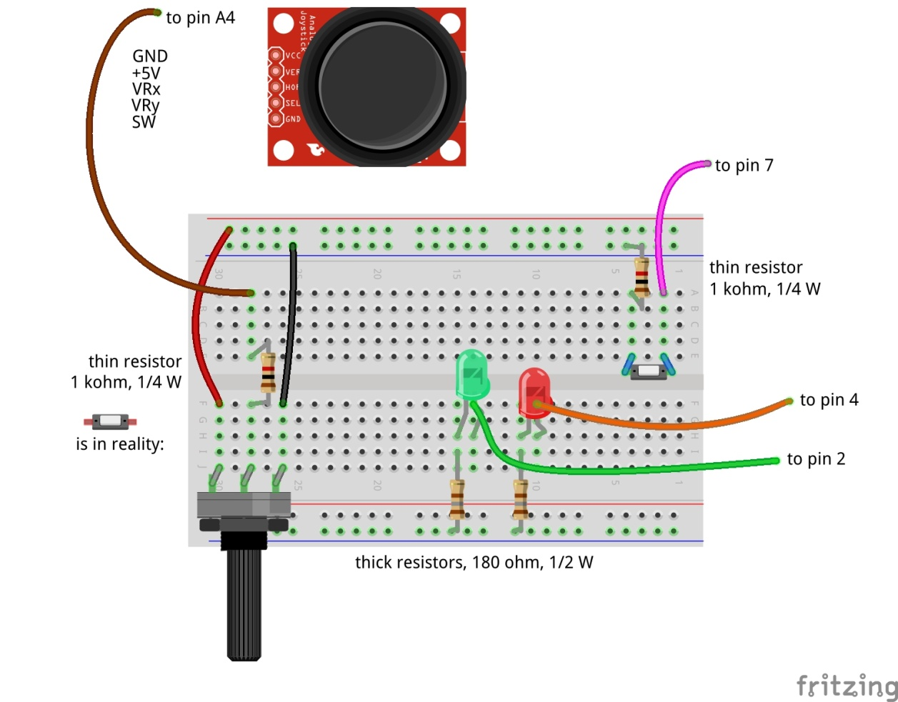
Adding analog input
Don’t forget: power off and USB cable out before updating!

Slide 47
Update the config file
Update the config file again
Define Potmeter on pin A4 (direction: input, function: analog)
Now that you are updating anyway, already define for the next steps:
Define Servo 1 on pin 12 (direction: output, function: servo)
Define Big Blue LED on pin 5 (direction: output, function: PWM)
Define Buzzer on pin 11 (direction: output, function: PWM)
Don’t forget to save

Slide 48
Test whether it works
Stop and restart scratchClient
Reconnect and repower the board
Make the sensor Potmeter visible
Turn the knob and see the values change
Between about 0 and about 1024
We will write some Scratch program to use it in the next step

Slide 49
Part 8: Pulse Width Modulation

Slide 50
Where we are …
We have seen:
Digital Input (the button)
Digital Output (the LEDs)
Analog Input (the potentiometer)
So what would be most logical next?
Analog Output – but it does not exist!
However there is a good alternative: Pulse Width Modulation

Slide 51
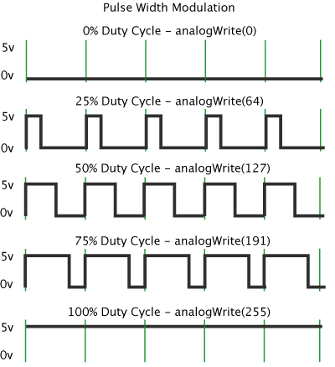
Pulse Width Modulation (PWM)
By modulating (changing) the pulse width, the amount of energy fed to the e.g. LED is changed, and hence the intensity with which you see it lighting.
Note that in practice the LED is blinking some 800 blinks / second.
However, no human eye can see more than 100 blinks / second.

Slide 52
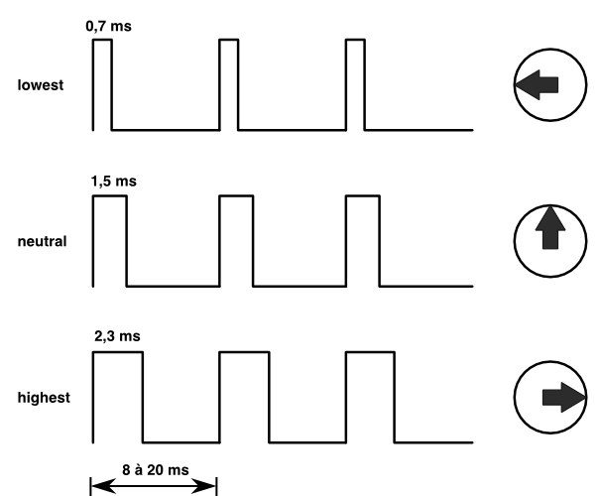
Controlling a servo with PWM
The position of the servo is changed by sending pulses of different width.
The servo looks at the pulsewidth and turns as desired.
The servo gets power separately.
With a servo, the pulse width modulation is not controlling the amount of energy fed to the servo
With a servo, pulse width modulation is rather a communication protocol.

Slide 53
Adding the servo to pin 12
Dark brown wire here
Don’t forget: power off and USB cable out before updating!

Slide 54
Test
Switch the power on again and reconnect
You will see that scratchClient finds the board again
You already updated the config file in the previous step, so no need to restart scratchClient
Define in Scratch a variable Servo 1
Make the variable visible
Give Servo 1 values between 0 and 255
You can use the slider on the displayed variable for values between 0 and 100
For values above 100 we will use a program, see next slide
Does the servo turn?

Slide 55
Connect Potmeter and Servo (via Scratch)
Make the sensor Potmeter visible.
Make some code that takes the potentiometer reading (between 0 and 1024) and transforms it into the range 0 to 255 (so divide by 4) and set the value of Servo 1.
Try out whether turning the potmeter changes the servo position.
You will observe jitter.
Because the values of the potmeter will drift a bit and there will be power fluctiations, the reading of the potmeter will not be constant
We will later see how to deal with this

Slide 56
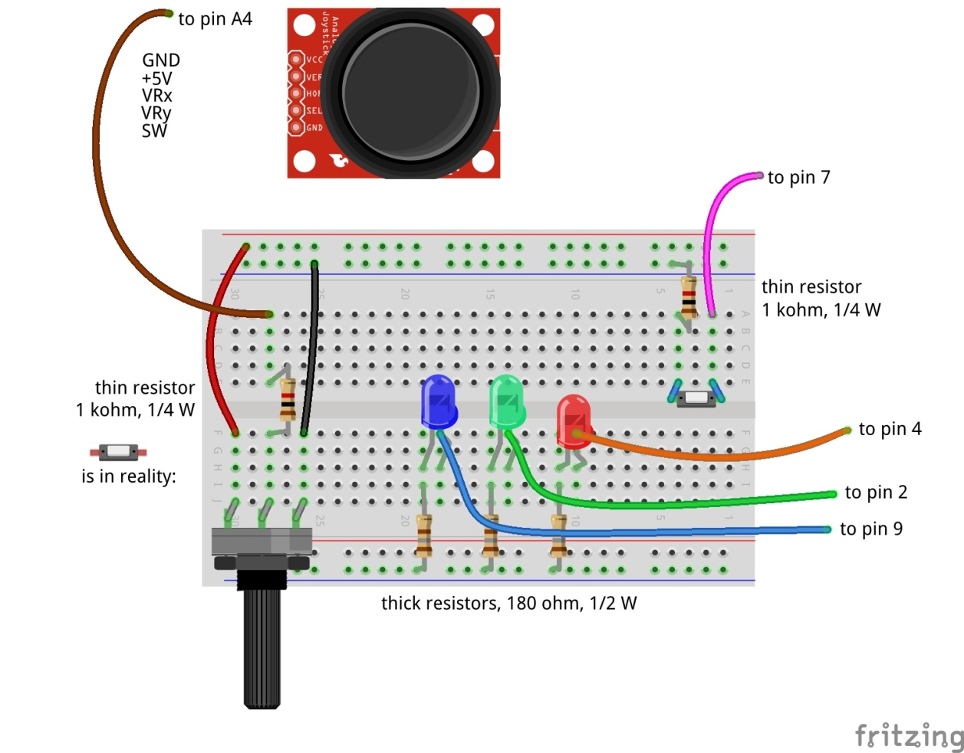
Dimming a LED with PWM
Don’t forget: power off and USB cable out before updating!

Slide 57
Testing the Big Blue LED
Reconnect and repower the board
In Scratch, create a variable Big Blue LED and make it visible.
Try out giving it values between 0 and 100 via the slider on the variable.
Update the loop where you set the servo position based on the potmeter reading to now also set the Big Blue LED.
Notice that when turning to the right, the intensity goes down.
This is not what you expect.
How can you very simply change this by interchanging two wires?

Slide 58
Controlling a buzzer with PWM
The buzzer will sound if it gets a signal in an audible frequency range.
A PWM signal on Arduino gives ca. 800 Hz.
Different for different pins
You will see that there is not much influence by changing the duty cycle.

Slide 59
Connect the buzzer to pin 11
Carefully watch the wires. Connect Vcc, GND and I/O!
Don’t forget: power off and USB cable out before updating!

Slide 60
Testing the buzzer
No need to restart scratchClient, because the config file was not changed.
Define a variable Buzzer in Scratch
Give it values between 0 and 100
Using the slider on the variable
Does the value have much impact?
Add the setting of the buzzer to the loop where you already set the servo and the Big Blue LED.
Only test a short time (to save the ears of your neighbors ☺).

Slide 61
PWM limitations of Arduino (Nano and Uno)
General PWM is available on pins 3, 5, 6, 9, 10, 11
Servo can be configured on those pins, but also on 2, 4, 7, 8, 12
If a servo is configured on any pin, pins 9 and 10 cannot be configured as PWM anymore.
The config tool will warn you if you do it wrongly.

Slide 62
Take care of the jitter (1 of 2)
In Scratch, only react if the potentiometer has changed a minimal amount.
Add this and see the results.

Slide 63
Take care of the jitter (2 of 2)
The program on the previous slide removes the jitter, however also may influence the ability to make fine adjustments.
Hence: only remove the jitter if the potentiometer has not been turned for e.g. 1 second.
Add this and see the results.

Slide 64
Part 9: Make a Scratch program
Extra material in case you have time left

Slide 65
Integrate with sprites
Load the following sprite
Big Red LED
Take a look at the code of the sprite
Update the code that you wrote earlier today for the Big Red LED so that it sends messages to the sprite to turn the LED on and off

Slide 66
Add the Big Green LED sprite
Same that you did with the Big Red LED sprite, but now for the Big Green LED sprite.

Slide 67
Add the Big Blue LED sprite
Load the Big Blue LED sprite
Analyse the code in that sprite, which is different
The Big Blue LED sprite can will move over the screen as the intensity changes
You can also move it with your mouse and see the intensity change.
Update your code that you wrote earlier to make use of the sprite.

Slide 68
Part 10: Saving your setup

Slide 69
Do you want to take your work home?
If you brought your own USB stick, then connect it and copy the PiAndMore folder on the desktop
The rest of the material you can download from github.
Take the flyer with you to remember where to find the material.

Slide 70
Clean up / teardown

Slide 71
If you continue to the Advanced Workshop …
You can continue to use your setup, with one exception:
You need to move the Big Blue LED to pin 9
Direction: output, function: output (so no PWM)
In the mean time you should know how to do this, otherwise please ask.

Slide 72
If your scratchClient day ends here …
Unplug the board from USB and power off the device
Please remove all components and wires from the breadboard
Remove all wires from the Arduino board.
Leave the wires on the 3 color LED (you did not use that)
Leave the wires on the side of the buzzer
If something is broken, please
Throw it away
Put a note in the box that it is missing
Leave the Arduino running
Let us know what you thought about this workshop, now orally or later by email
hans.piam@hanselma.nl
heppg@web.de

Slide 73
More information
All workshop material
www.github.com and search for Weekendschool or for PiAndMore
scratchClient
http://heppg.de/ikg/wordpress/?page_id=6
Scratch
https://scratch.mit.edu/
Scratch on Raspberry Pi
https://www.raspberrypi.org/forums/viewforum.php?f=77
Raspberry Pi
https://www.raspberrypi.org/
Arduino
https://www.arduino.cc/

Slide 74
End of the beginners workshop

Slide 75
Physical computing from Scratch using scratchClient – Advanced Control servos, LEDs and more from Scratch using RPi, Arduino, scratchClient
Hans de Jong & Gerhard Hepp
Pi And More 10
Trier – 24 June 2017

Slide 76
Before we start

Slide 77
If you start at the advanced workshop …
If you are familiar with scratchClient, but not with the new config tool …
… you may want to look at some slides of the beginners workshop
Other than that, you do not have to build up the complete setup what the people of the beginners workshop did.
Only those things on the next slide.
You will however see the components of the beginners workshop in the diagrams.
Just ignore those.

Slide 78
To be done if you start here …
Do the actions on slides ….

Slide 79
Make the config file for all steps
In order not to loose time, it is recommended to define all setups in the config file at the beginning.

Slide 80
Choose the topics you want to give priority
The workshop may be too short to do all activities.
So pick the order of the topics from the list
The red topics teach you more about scratchClient
The green topics teach you more about electronics, sensors and engineering
Joystick
Control position or control speed
Take care of calibration and drift
3-color LED
To make any color
Counter function
With button or IR slotted sensor
Rain sensor
Tilt sensor
Microphone input
Strongly link the config file to the Arduino
For safety
For connection errors
Control multiple Arduinos concurrently
Power On Self Test
Controlling a relay
Controlling 220 Volt appliances
Controlling a camera

Slide 81
Joy stick

Slide 82
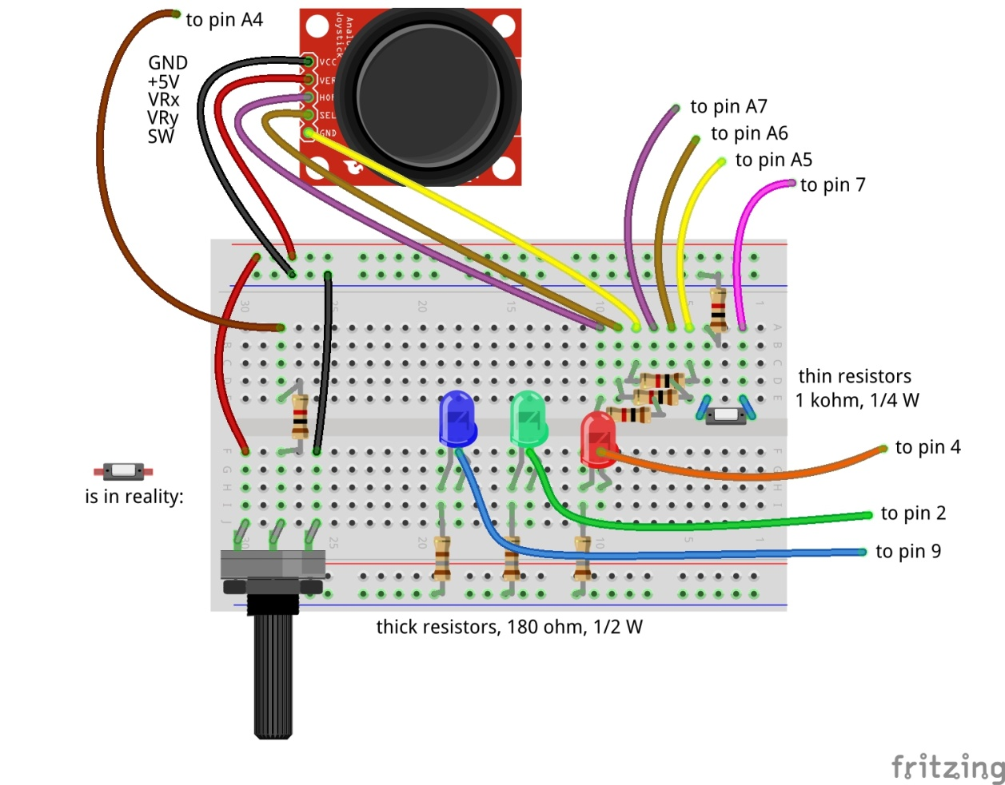
Adding the joy stick

Slide 83
Add a Joystick
Update the config file:
Jo

Slide 84
Uses of Joysticks
You can directly use the value of the joystick
E.g. to control the position of a servo
E.g. to control the intensity of a LED
When release the knob, it will then move to the middle value.
You can alternatively use the joystick determine the speed of the change
E.g. move a servo fast or slow. Let the servo stop at the latest position when you release the knob.
You can also use the Scratch pen function draw on the screen.
And e.g. use the potentiometer to change pen width or color.
Take care of drift (see next slide)

Slide 85
Take care of drift
Not all joysticks will give the same value if they are in the middle position
Influenced by temperature, the value produced in the middle position can drift over time.
Therefore build in some threshold around the middle position
If the middle position is 512, then do only react if the value changes by at least 5, so > 517 or < 507.
Whether 5 is enough as threshold you will learn over time. Increase if it drifts more than that.
If you have a general program that works with several joysticks then you may have to use a larger threshold, or you need to calibrate (adapt the program for each particular servo).

Slide 86
Control a 3-color LED
To make all colors

Slide 87
Control a 3-color LED
A 3-color LED has 3 LEDs in one package
Green
Red
Blue
Use PWM to change the intensity of each color
In that way you can create the entire spectrum of light
Including white light
Use pins …….
If you still have pin xx for the separate green LED, then disconnect that one
Since also a servo is connected, pins 10 and 11 cannot be used for PWM and only 4 PWM pins are left (of which one is used for the buzzer).

Slide 88
The new counting function

Slide 89
Why a special counting function
You can count in Scratch, however you can only reliably count a few per second.
With this new counting function, you can do it much faster
If you need to detect small pulses that scratchClient may not see, you can use a counter function to detect whether a pulse did arrive.

Slide 90
Counter function using a button
Update the config file to include a counter on pin
It will count up. It will wrap round at a very large value that will be reached after days of counting.
Max. ca. 80 counts per second = 4800 per minute
There is a 4 ms debouncing delay
So multiple pulses within 4 ms will processed as a single count
So no need for capacitors to do debouncing

Slide 91
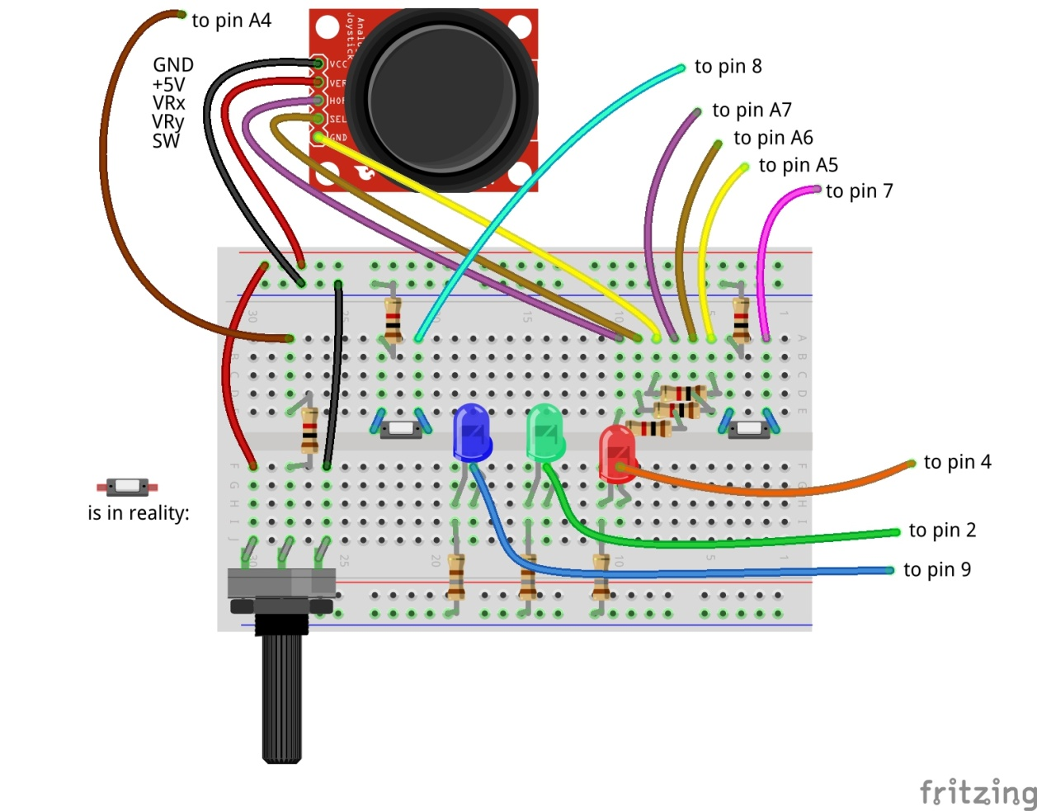
Adding the count button

Slide 92
Counter using an IR slotted sensor
It does not need a pull up resistor

Slide 93
Connect the IR slotted sensor

Slide 94
Tilt sensor
Adapt the config file for a tilt sensor

Slide 95
Rain sensor

Slide 96
Microphone input
You can only react on audio being present or not.

Slide 97
Strongly link the config file to the Arduino

Slide 98
The ident functionality

Slide 100
Controlling multiple Arduinos

Slide 101
Control multiple Arduinos

Slide 102
Debouncing

Slide 103
Power on self test (POST)

Slide 104
Power on self test

Slide 105
Controlling a relay

Slide 106
Use a servo to press buttons on appliances

Slide 107
Safely controlling 220 Volt appliances
You can in principle use a relay to control 220 Volt appliances.
However, this is not something you want to do in a classroom situation
Alternative: use a remote control and use servos to press the buttons.

Slide 108
Controlling a camera
Use a servo to press the button of the camera
Cannot do in the workshop

Slide 109
Do you want to save your setup?
If you brought your own USB stick, then connect it and copy the PiAndMore folder on the desktop
The rest of the material you can download from github.

Slide 110
Clean up
Please disconnect all components and all wires and put them in the box
Put the pliers in the box
Put the USB cable in the box
Put the empty board in the box on top
Shutdown the Raspberry Pi and then switch off the power.
We will take care of the rest.

Slide 111
Maximum current per pin
Max output current per pin = 20 mA
Total current for the board: 1 A
Note that also the potentiometer and the joystick take power

Slide 112
Can scratchClient do more? Yes!
It can also let you configure and use the GPIO pins on the Raspberry Pi itself.
However be aware:
There is no analog input on Raspberry Pi.
The pins are NOT 5 Volt tolerant (max 3.3 Volt).
The max current per pin on Raspberry Pi is lower than on Arduino.
If you blow up an Arduino (clone), the cost is limited to a few euro.
A Raspberry Pi is much more expensive.
scratchClient can also control Sonic Pi for high quality audio.
There are also Arduino sketches to control LED strips (Neopixel WS2812) and to control LEGO Power.
scratchClient can work with Scratch 2.0 (soon).
scratchClient can also run on Windows and then via Arduino control peripherals.
scratchClient can work with multiple Raspberry Pi configurations in a network.

Slide 113
Taking material home, clean up
See slides xxxx in the beginners workshop (in this presentation).

Slide 114
We love to hear from you
If you have any questions or remarks about this workshop then send us an email:
hans.piam@hanselma.nl
heppg@web.de

Slide 115
End of the Advanced Workshop

Slide 116
Appendix

Slide 117
Cost of the setup (1 of 2)
This is a list of the cost of the setup of the external board.
Not included is the cost of the perspex board and the nuts and bolts, which are not an absolute minimum requirement
And for which there are alternatives, e.g. use cardboard or an MDF board
All material comes from Aliexpress
Very cheap
Often no shipping costs to Europe
Takes between 2 weeks and 2 months
Or never arrives, but then money is promptly returned.
When ordering below 22 euro, no import duties and handling costs

Slide 118
Cost of the setup (2 of 2)

Slide 119
The End

